Slide 1

Program in Neuroscience

Slide 2
Goals for today:
  Understand the basics of our two neuroscience majors
  Get familiar with our website
  Build a schedule

Slide 3
Pre-Requisites (37-40 hours)
The Neuroscience Major
BSC2010/L Biological Science I with lab
BSC 2011/L Biological Science II with lab
CHM1045/L General Chemistry I with lab
CHM1046/L General Chemistry II with lab
CHM2210 Organic Chemistry I
CHM2211 Organic Chemistry II
PHY2053C Physics I
PHY2054C Physics II
STA2122 Intro. to Applied Statistics
MAC2311 Calculus I

Slide 4
Core Courses (19 hours)
The Neuroscience Major
PSB2000 Intro. to Neuroscience
PSB4400 Neuroscience Methods
PSY3213C Research Methods in Psychology
PSB3004C Physiological Psychology with lab
PCB3134 Cell Structure and Function
PCB4843 Fundamentals of Neuroscience

Slide 5
Electives (17 hours)
The Neuroscience Major
Approved course list only
Behavioral
Neuroscience
Cell and Molecular Neuroscience
6 hours Biology
11 hours Psychology
6 hours Psychology
11 hours Biology

Slide 6
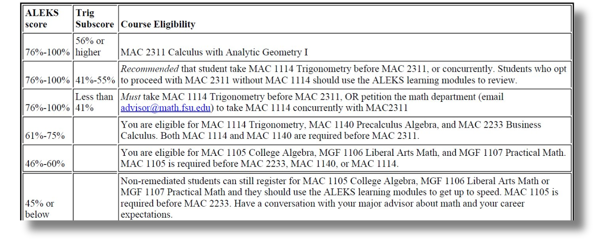
All students must take the ALEKS exam unless you tested out through AP/IB/AICE/Dual Enrollement.
Math Sequence

Slide 7
Math Sequence
MAC1105
MAC1140
MAC1114
MAC2311
College Algebra
Pre-Calculus
Trigonometry
Calculus I
STA2122
Intro. to Applied Statistics
STA2023 (AP Statistics credit) does NOT count for the major.
You will need to take STA2122.

Slide 8

Freshman Interest Groups
  Pre-packaged schedule
  Only offered in Fall of Freshman year​
  Includes:
    2-3 classes
    1 hr. colloquium​
  Great way to meet like-minded classmates & register for high-demand courses​
  Counts as ENGAGE 100​
  More Info in It’s All Academic

Slide 9
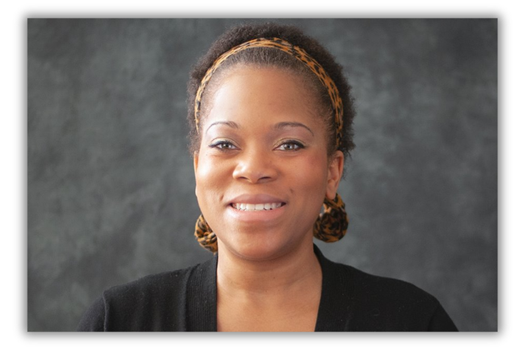
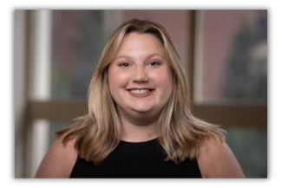
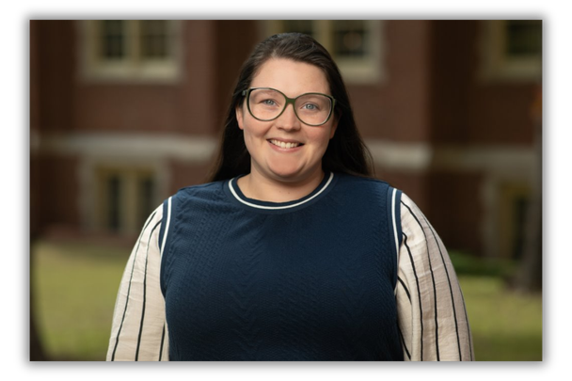
Neuroscience Advising
Jacquelyn Roberts​
jroberts@neuro.fsu.edu​
Psychology Bldg A209C
Lindsey Carrier​
lindsey.carrier@fsu.edu​
Psychology Bldg A209B
Sabrina Roland​
sabrina.roland@fsu.edu​
Psychology Bldg A209A
We offer:​
Zoom appointments ​
Walk in/Drop in Hours ​
To check into in-person or drop-in appointments, go to Main Psychology/Neuroscience office in PDB A209

Slide 10

Our Website

Slide 11
Summer Scheduling
Build your schedule in the following order, stop when you hit 3 courses. Confirm schedule with advisor.
Maximum of 2 Classes and Engage 100 Course:
  Add ENC1101 or ENC2135
  Add Math or Statistics class, if applicable
  Add PSB2000
  Add an Ethics, Exploring Human Experience, or Oral Competency
  Add an Engage 100 course

Slide 12
Fall Scheduling
Build your schedule in the following order, stop when you hit 15 credit hours. Confirm schedule with advisor.
Maximum of 12-15 Credit hours Classes including Engage 100.
  Add ENC1101 or ENC2135
  Add Math or Statistics class, if applicable
  Add PSB2000
  Add BSC2010/L or CHM1045/L (credit earned for math)
  Add a Psychology elective
  Add an Ethics, Exploring Human Experience, or Oral Competency
  Add an Engage 100 or join a FIG

